Slide 1

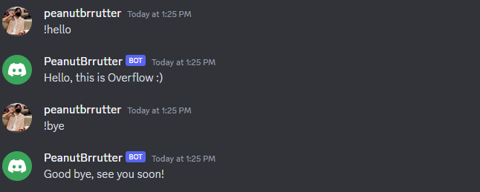
Discord Bots!
Part 1
Coding with Python (again) ☺

Slide 2
What is a Discord bot?
Automated program that performs various tasks on the Discord platform.
Can interact with users, provide information, moderate servers, play music and more.
Through text-based messaging in chat channels, responding to commands, inquiries or specific triggers (prefixes)
Can leverage Discord’s API to access and manipulate server and user data, enabling powerful interactions and functionalities.

Slide 3
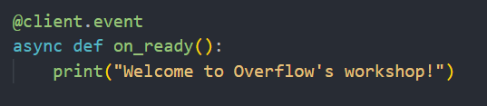
What YOU can expect
This is the first Discord bot workshop out of the two-part series
What we will be covering in today’s workshop:
Basic event handling
Basic command handling & mention commands
Slash commands & sub-commands
At the end of today’s workshop, you will be able to build and customise your Discord bot with the above features.

Slide 4
Development with Python Libraries
Discord.py – widely-used library that provides a high-level API for building Discord bots in Python.
Discord.py rewrite – updated version of discord.py, ensuring compatibility with the latest changes in the Discord API.
Comes with comprehensive documentation (examples, tutorials and API references).
Allows for easy customization and extension, enabling developers to add their own functionality.

Slide 5
LET’S GET STARTED! ☺

Slide 6
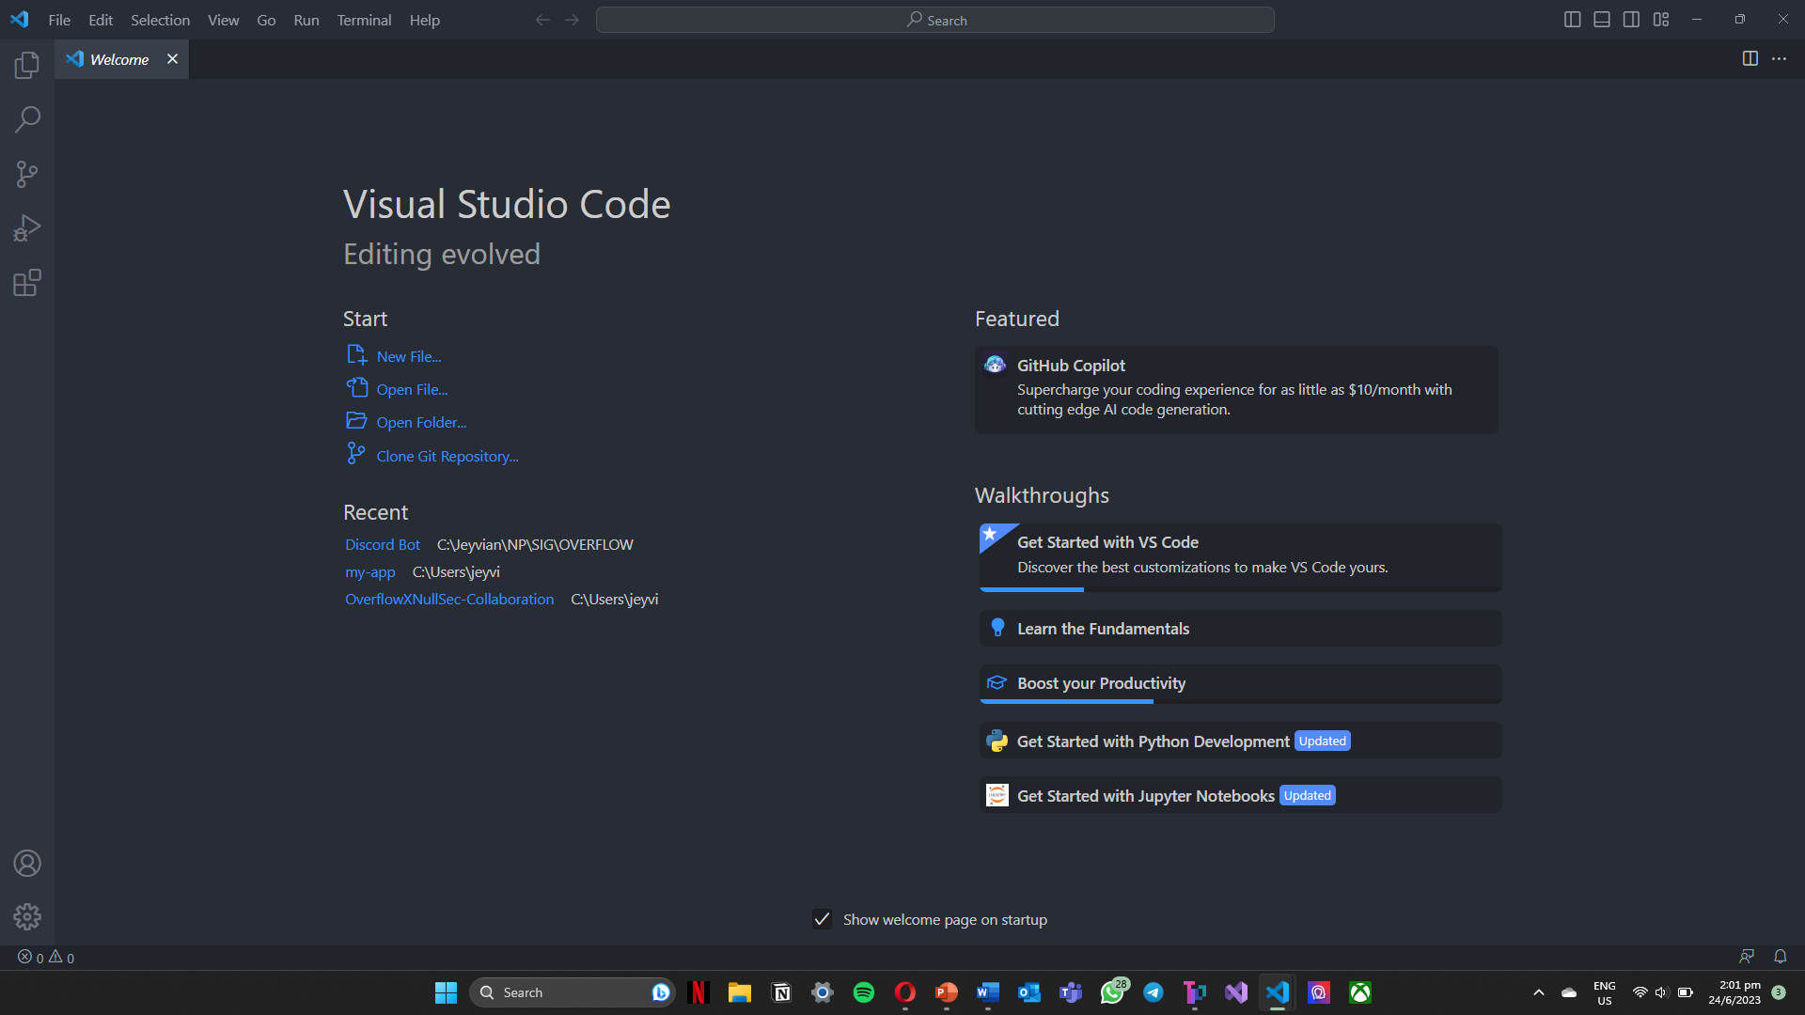
Create Python file
Create a new Python file in your desired directory in Visual Studio Code.

Slide 7
Importing Libraries
Importing the main ‘discord’ module (core library for interacting with the Discord API)
Importing ‘commands’ submodule from the ‘discord.ext’ package (used later!)
`discBot.py`
import discord
from discord.ext import commands

Slide 8
Setting Bot Token
Assign the variable BOT_TOKEN to your bot’s token surrounded in double quotations
At the end of your code, add the line bot.run(BOT_TOKEN)
`discBot.py`
BOT_TOKEN = “ABCDEFGHIJKLMNOPQRUSTVWXYZ123456789abcdefghijklmnopqrstuvwxyz"
bot = commands.Bot(command_prefix = "!", intents = discord.Intents.all())
# Rest of code
bot.run(BOT_TOKEN)

Slide 9
Basic Event Handling

Slide 10
@bot.event
Decorator to define an event handler for the Discord bot.
Indicates that the function will be executed when the corresponding event occurs.
Documentation: https://tinyurl.com/discordPythonDocumentation
`discBot.py`
@bot.event

Slide 11
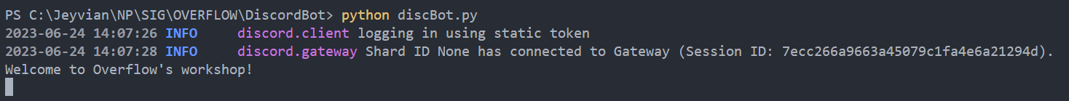
On Ready
Triggered when the bot successfully connects to the Discord server
Ready to start receiving and responding to events and commands
Prints the message to the console/terminal
`discBot.py`
@bot.event
async def on_ready():
print("Welcome to Overflow's workshop!")

Slide 12
Receiving Member-Related Events
Intents: represents the various capabilities and events that your bot can receive from Discord API.
Enables ‘members’ intent → allows bot to receive member-related events (e.g., member joins/leaves, nickname changes)
`discBot.py`
intents = discord.Intents.default()
intents.members = True

Slide 13
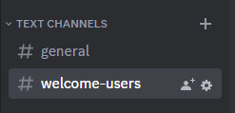
Setting Channel
Assign the variable BOT_CHANNEL to the channel ID of the channel you desire the bot to respond to with regards to member-related events.
In my case, I have created a text channel called ‘welcome-users’ to welcome user when they join.
`discBot.py`
BOT_CHANNEL = 12345678901234567890

Slide 14
Member Join
member → member who has joined the server
channel → specifying the channel to send the message to
await → operation is asynchronous (does not block execution of other code)
member.mention → pings the user
`discBot.py`
@bot.event
async def on_member_join(member):
channel = bot.get_channel(BOT_CHANNEL)
await channel.send("Welcome {}".format(member.mention))

Slide 15
Member Leaves
Same as the previous slide, but now member represents the member who has left the server.
`discBot.py`
@bot.event
async def on_member_remove(member):
channel = bot.get_channel(BOT_CHANNEL)
await channel.send("Goodbye, you will be deeply missed :(")

Slide 16
Receiving Message-Related Events
Intents: represents the various capabilities and events that your bot can receive from Discord API.
Enables ‘message_content’ intent → allows bot to receive the message contents in the discord channel
`discBot.py`
intents.message_content = True

Slide 17
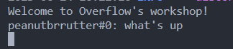
Message Sent
message.author → retrieves author of message
message.content → retrieves content of message
`discBot.py`
@bot.event
async def on_message(message):
author = message.author
content = message.content
await bot.process_commands(message)
print("{}: {}".format(author, content))

Slide 18
Message Delete
Same as previous slide, but now we are sending the message to the channel instead of the console.
The variable channel here refers to the channel the message is sent in.
`discBot.py`
@bot.event
async def on_message_delete(message):
author = message.author
content = message.content
channel = message.channel
await channel.send("{}: {}".format(author, content))

Slide 19
Message Edit
Same as the previous two slides, but now we have the before and after variables.
`discBot.py`
@bot.event
async def on_message_edit(before, after):
author = before.author
channel = before.channel
before_content = before.content
after_content = after.content
await channel.send("Before: {}".format(before_content))
await channel.send("After: {}".format(after_content))

Slide 20
Message Edit
Prevent the event on_message_edit to be triggered twice for each message edit.
Checks if the edit was made by the bot itself or the user.
`discBot.py`
@bot.event
async def on_message_edit(before, after):
if before.author == bot.user:
return;

Slide 21
Reaction Added
Same syntax as the previous few events, except that the arguments are reaction & user.
`discBot.py`
@bot.event
async def on_reaction_add(reaction, user):
channel = reaction.message.channel
name = user.name
emoji = reaction.emoji
content = reaction.message.content
await channel.send('{} has added {} to the message: {}'.format(name, emoji, content))

Slide 22
Reaction Removed
Same as the code for reaction added ☺
`discBot.py`
@bot.event
async def on_reaction_remove(reaction, user):
channel = reaction.message.channel
name = user.name
emoji = reaction.emoji
content = reaction.message.content
await channel.send('{} has removed {} to the message: {}'.format(name, emoji, content))

Slide 23
Break Time!!! ☺ WOOHOO

Slide 24
Basic Command Handling & Mention Commands

Slide 25
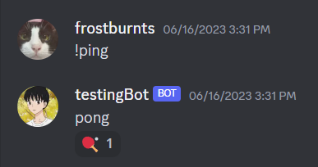
Prefix Commands
Commands that starts with a prefix
E.g., “!”, “$”, “*”
How they look like:

Slide 26



Prefix Commands (Coding)
Now let's start defining its actions
For now, let's focus on 3 core things:
Send, react and delete

Slide 27
Prefix Commands (Coding)
Start by specifying the intents
message_content = true : allow our bot to access contents of messages
Afterwards, specify the prefix
`discBot.py`
Prefix
intents = discord.Intents.default()
intents.message_content = True
bot = commands.Bot(command_prefix="!", intents=intents)
Intents

Slide 28
Prefix Commands (Coding)
Start with the @command section
Define the command name along with the parameters
ctx in here refers to context: It provides useful information about the command
Such as the author or even channel of where the command is found at!
`discBot.py`
@bot.command()
async def ping(ctx):

Slide 29
Prefix Commands (Coding)
Send Messages
Remember the ping pong command showed earlier?
To send messages, just simply add the ctx.send method
`discBot.py`
@bot.command()
async def ping(ctx):
mention = await ctx.send("pong")
await mention.add_reaction("🏓")

Slide 30
Prefix Commands (Coding)
Reacting to Messages
Use the .add_reaction method
Remember to specify the emoji!
`discBot.py`
In this instance, the bot reacted to its own message
@bot.command()
async def ping(ctx):
mention = await ctx.send("pong")
await mention.add_reaction("🏓")

Slide 31
Prefix Commands (Coding)
How to make them react to your own message?
Access your own message via the ctx object
Use the .add_reaction method on the ctx object
`discBot.py`
@bot.command()
async def ping(ctx):
mention = await ctx.send("pong")
await ctx.message.add_reaction("🏓")

Slide 32
Prefix Commands (Coding)
Deleting Messages
Access the messages using the channel history
Specify the conditions for deleting the messages
Afterwards, use the delete method
`discBot.py`
@bot.command()
async def delete(ctx, user: discord.User):
async for message in ctx.channel.history(limit=None):
if message.author == user and message.id != ctx.message.id:
await message.delete()
break

Slide 33
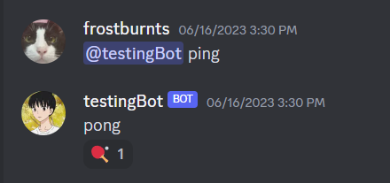
Mention Commands
They are like prefix commands
Mention the bots instead of using a prefix to call the commands
How they look like?

Slide 34
Mention Commands (Coding)
Coding syntax wise, they are basically the same
However, the only difference is how you specify the command_prefix
Instead of applying a string prefix, you do this:
`discBot.py`
bot = commands.Bot(command_prefix=commands.when_mentioned, intents=intents)
bot = commands.Bot(command_prefix=commands.when_mentioned_or("!"), intents=intents)
This is used when you want to include both prefix and mention commands

Slide 35
Slash Commands

Slide 36
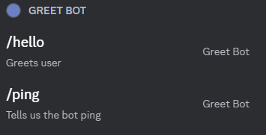
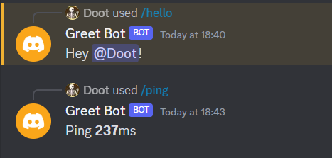
Slash Commands
Commands that starts with /
How they look like:

Slide 37
Slash Commands (Coding)
To check if the bot is ready and the commands have been synced
`discBot.py`
@bot.event
async def on_ready():
print("Bot is ready for use!")
print("---------------------")
try:
synced = await bot.tree.sync()
print(f'Synced {len(synced)} Command(s)')
except Exception as e:
print(e)

Slide 38
Slash Commands (Coding)
Description → will be shown beneath the command when you enter ‘/’
`discBot.py`
@bot.tree.command(description="Greets user")
async def hello(interaction: discord.Interaction):
await interaction.response.send_message(f"Hey {interaction.user.mention}! ")

Slide 39
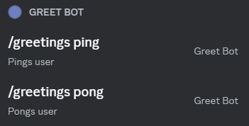
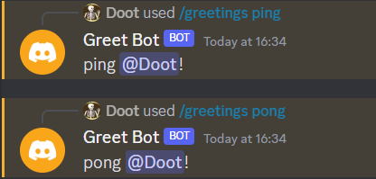
Sub Commands
Commands that start with the same name
How they look like:

Slide 40
Sub Commands (Coding)
Creates an instance of the Group class from the app_commands module
Instance is assigned to the variable mygroup and is configured with the name "greetings" and a description of "Welcomes users"
Serves as a way to group related functionality or data together under the "greetings" category
`discBot.py`
mygroup = app_commands.Group(name="greetings", description="Welcomes users")

Slide 41
Sub Commands (Coding)
Adds the mygroup object to the command tree of the bot instance
Allows the bot to execute or interact with commands or functionalities that are part of the mygroup object
`discBot.py`
bot.tree.add_command(mygroup)

Slide 42
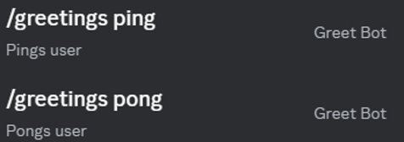
Sub Commands (Coding)
Use '@mygroup' instead of '@bot.tree'
`discBot.py`
@mygroup.command(description="Pings user")
async def ping(interaction: discord.Interaction):
await interaction.response.send_message(f"ping {interaction.user.mention}! ")
@mygroup.command(description="Pongs user")
async def pong(interaction: discord.Interaction):
await interaction.response.send_message(f"pong {interaction.user.mention}! ")

Slide 43
Next Workshop
What we will be covering in the next workshop:
Intermediate embedding & customisation
Bot moderation
API integration
GitHub repository:
https://github.com/np-overflow/discord_bot

